Slide 1
Music Generation using
LSTM and GAN
Yatri Patel
jwb318

Slide 2
Outline
Motivation
Data Source
Input music types
Pre-processing
Model types
LSTM structure
GAN structure
Output
Final Thoughts

Slide 3
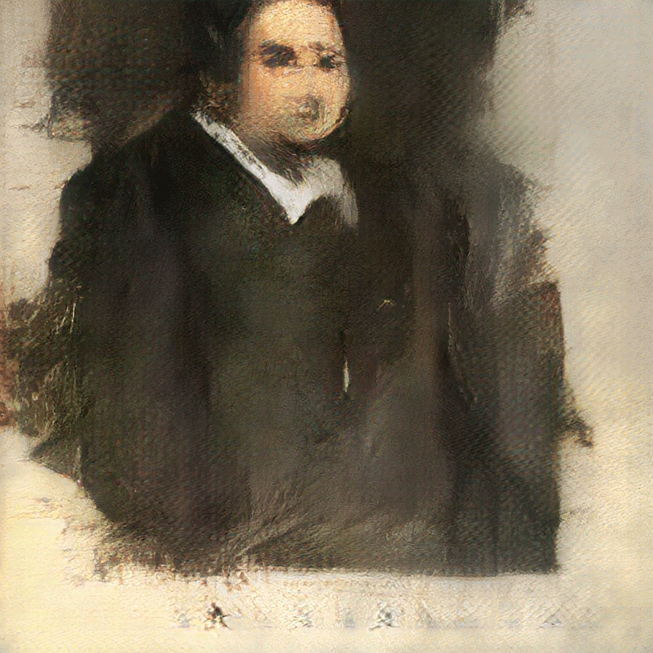

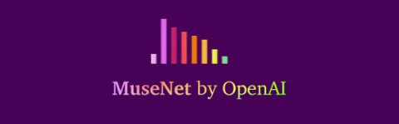
Motivation
The image was generated using GAN and was sold for over $400k
Can Neural Networks understand music and generate it?
MuseGAN
YES! It can!

Slide 4

Data sources
MIDI file format
Web scrapped from https://www.midiworld.com/
Two keywords:
Piano : 92 files
Movie themes : 91 files
Input file sample:
Piano:
Movie Themed

Slide 5
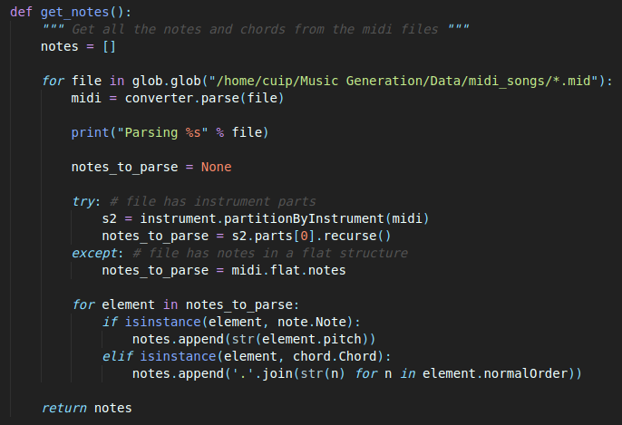
Data Pre-processing
Using the Music21 module, I was able to pre-process the data to get respective notes and chords.
Get notes, pitch and chord from the files
MIDI : metadata for the mp3 files
The sequence is prepared using notes, which is further categorised using one-hot key method

Slide 6
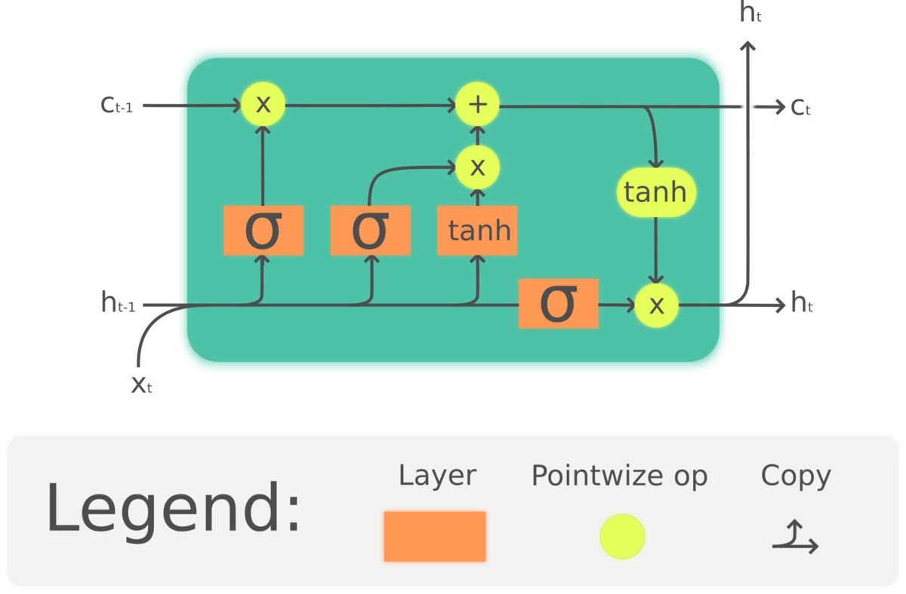
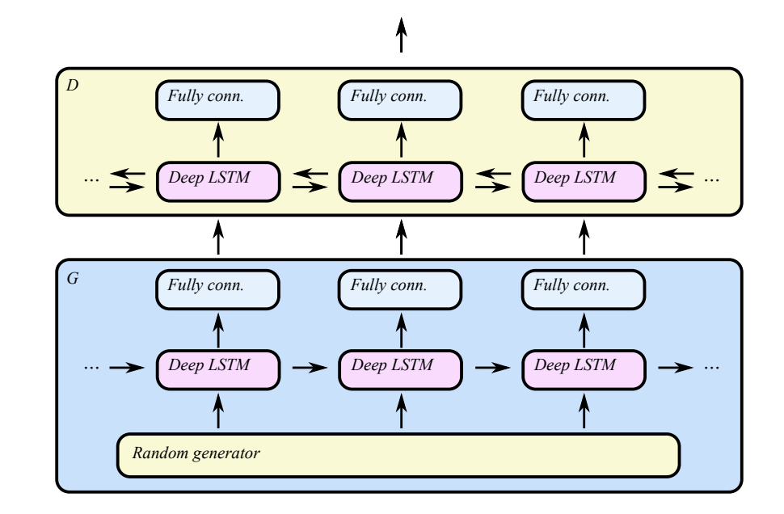
Models
LSTM :
An LSTM is a recurrent neural network
This model architecture shares feature weights over time which allows it to output somewhat coherent patterns.
C-RNN-GAN :
C-RNN-GAN is a recurrent neural network with adversarial training.
Hence, it has LSTM in its layers
LSTM Cell
C-RNN-GAN cell

Slide 7
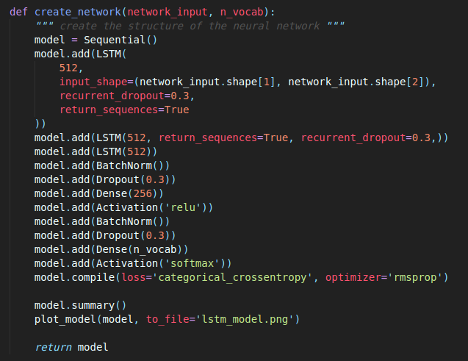
LSTM model
3 LSTM layers are important in the music generation as without those the model didn’t predict any nodes.
Dropout layer prevents the model from overfitting and the music to be similar to the input files.

Slide 8
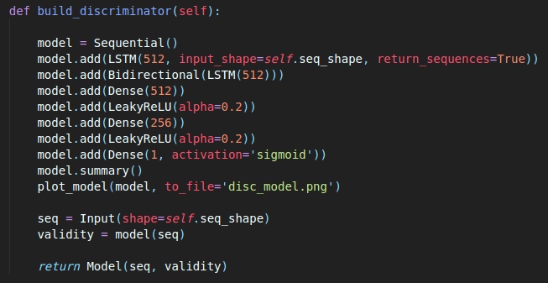
GAN model - Discriminator
In this model, the first two layers are LSTM layers.
Allows the discriminator to learn from our music inputs as sequential data during training.
Without them it was unable to distinguish between real and fake music, as long as generator was able to know the discrete domain of the input.
Notes:
Without these layers, we found that the discriminator was unable to distinguish real music from fake music as long as the generator was able to figure out the discrete domain of the input data.

Slide 9
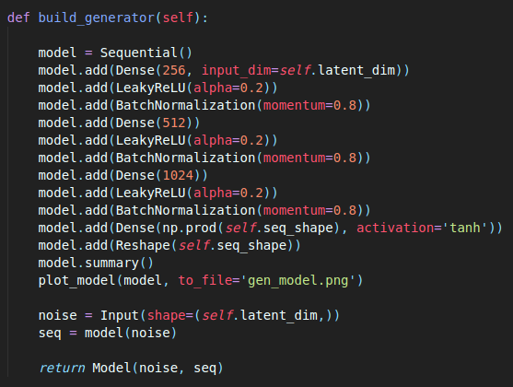
GAN model - Generator
Generator here is a simple Multi-layered perceptron that received random inputs equal to the size of the latent dimension.
Here, latent dimension is 1000 which improved the learning without having much difference in running time.

Slide 10
LSTM vs GAN
LSTM starts with a series of same notes, and have the model predict, which is our encoded output.
In GAN, we feed the generator a random sequence of numbers sampled from a standard normal distribution and have it make its prediction.

Slide 11
Outputs - LSTM
The output of the LSTM model using :
Piano themed input:
Movies themed input:

Slide 12
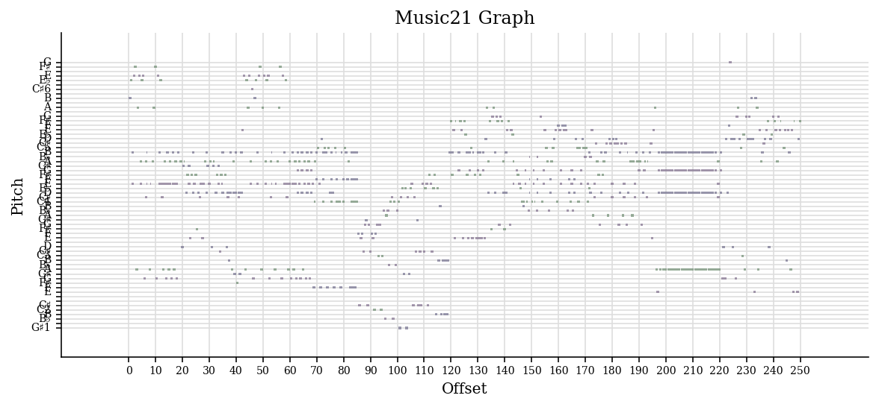
Music generated by Piano themed music as input

Slide 13
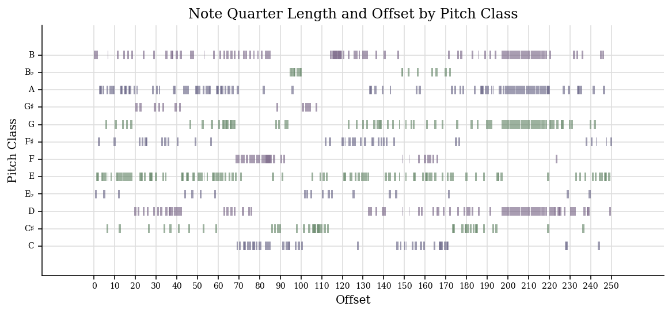

Slide 14
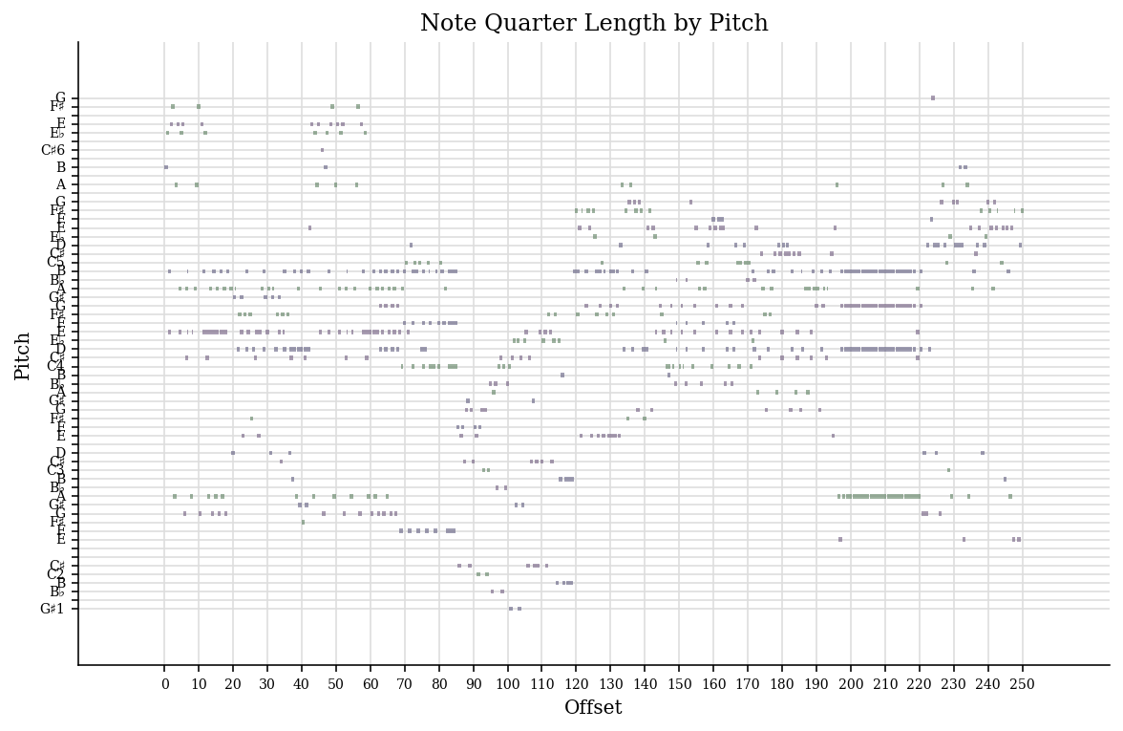

Slide 15
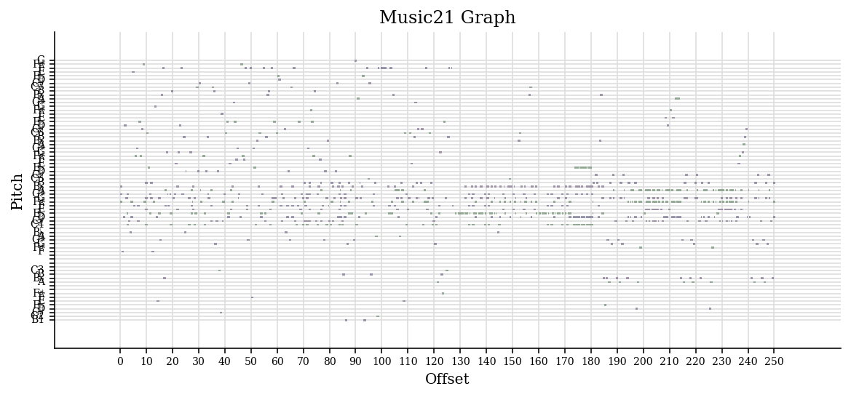
Music generated by Movie themed music as input

Slide 16
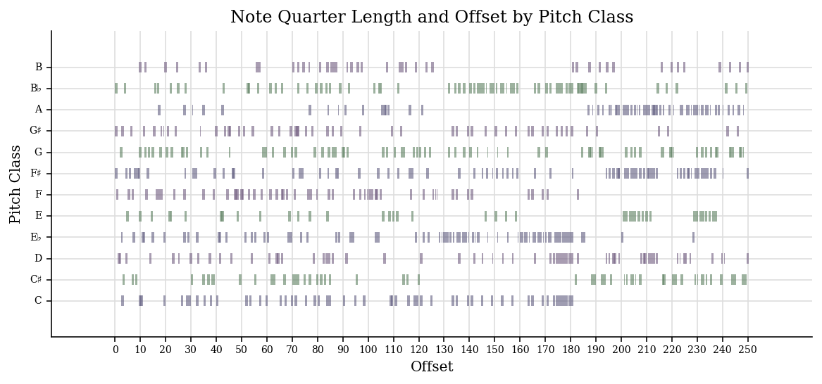

Slide 17
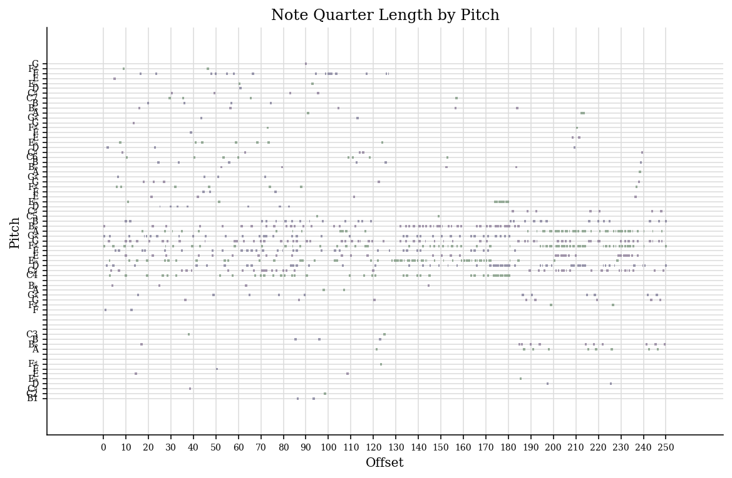

Slide 18
Outputs - GAN
The output of the LSTM model using :
Piano themed input:
Movies themed input:

Slide 19
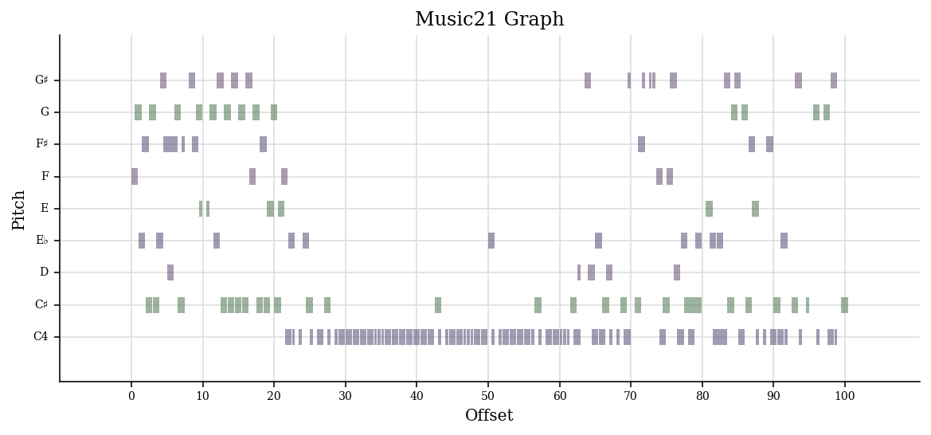
Music generated by Piano themed music as input

Slide 20
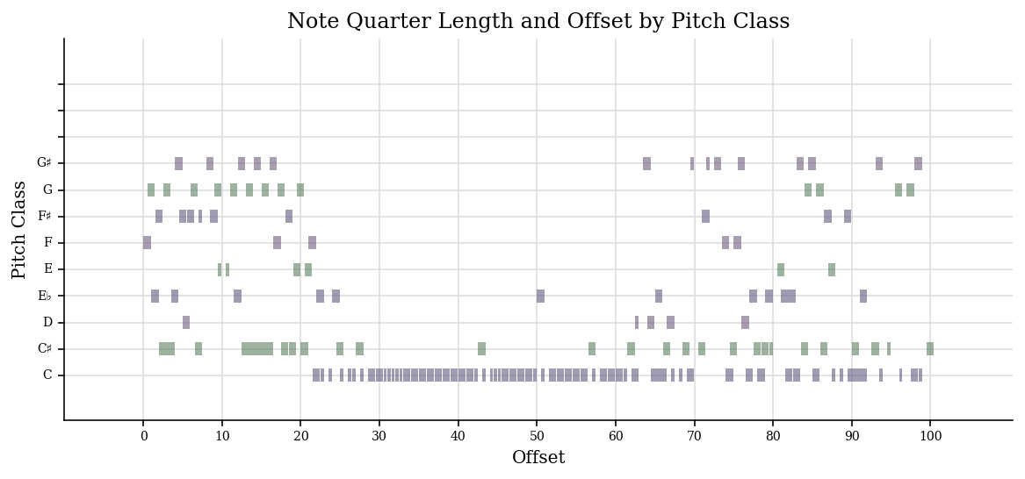

Slide 21
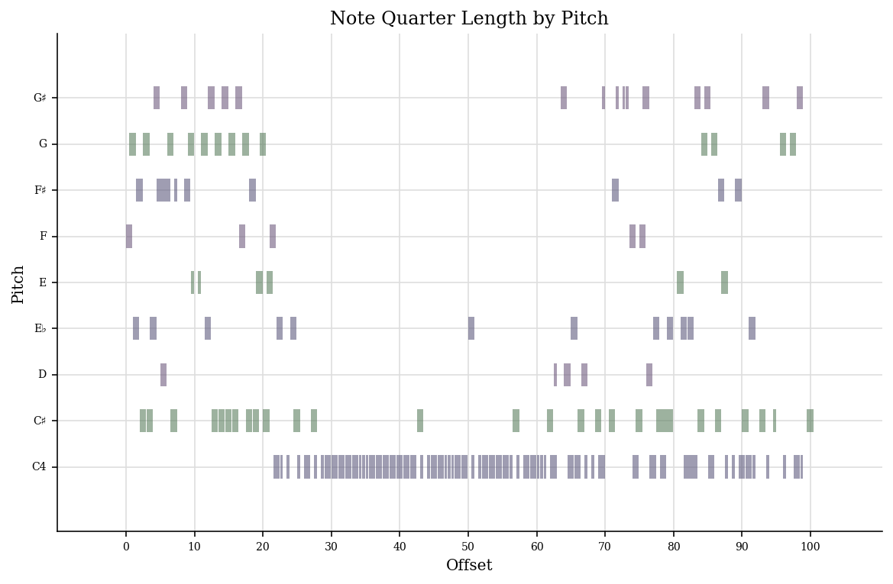

Slide 22
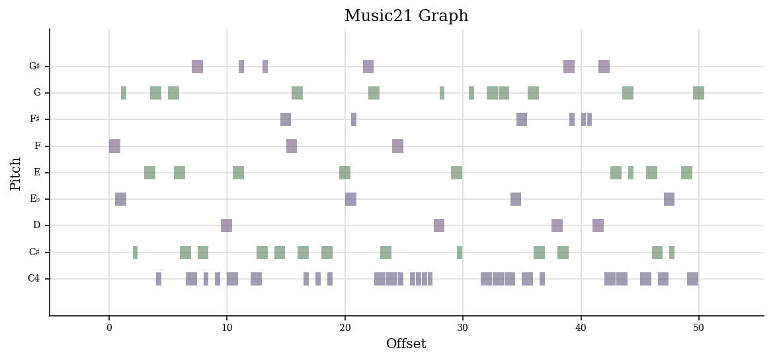
Music generated by Movie themed music as input

Slide 23
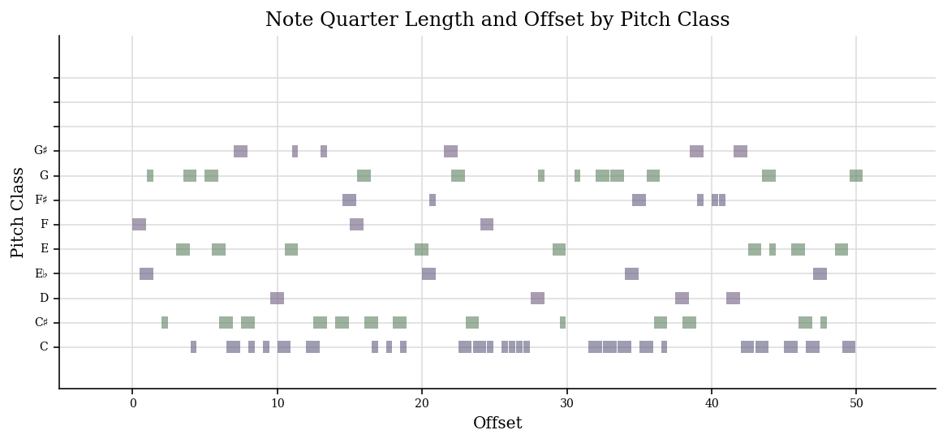

Slide 24
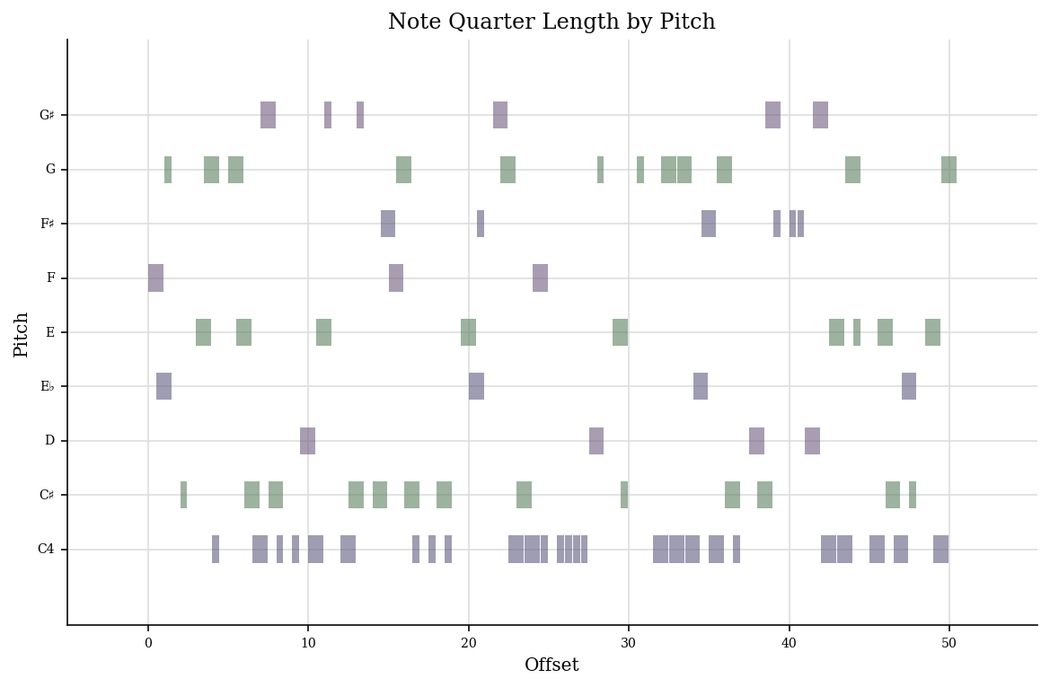

Slide 25
Final Thoughts
Improve the output:
Add more LSTM layers in the GAN network
LSTM : train longer with more epochs
Make different neural networks for different instruments and then combine them for a multi-instrumental music
LSTM outperformed GAN in terms of quality
GAN was much faster
Listen to the playlist and decide which one is better qualitatively:
https://soundcloud.com/yatri-patel-793078277/sets/lstm-gan-neural-network

Slide 26
Thank you!

